Slide 1
Linear Algebra
AI ToolKit
Fall Semester, 2023

Slide 2
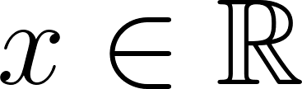

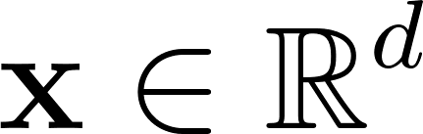
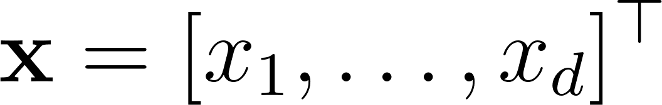


Scalars and Vectors
Scalar,
A single number.
Usually written with (normal lower-case letters).
Vector,
A fixed-length arrays of scalars.
Each scalar is called as “element”, “entries”, “components”.
Usually written with (bold lower-case letters).
Can be represented with arrows.

Slide 3
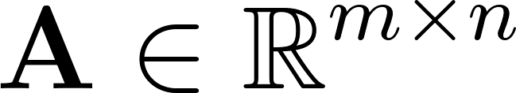



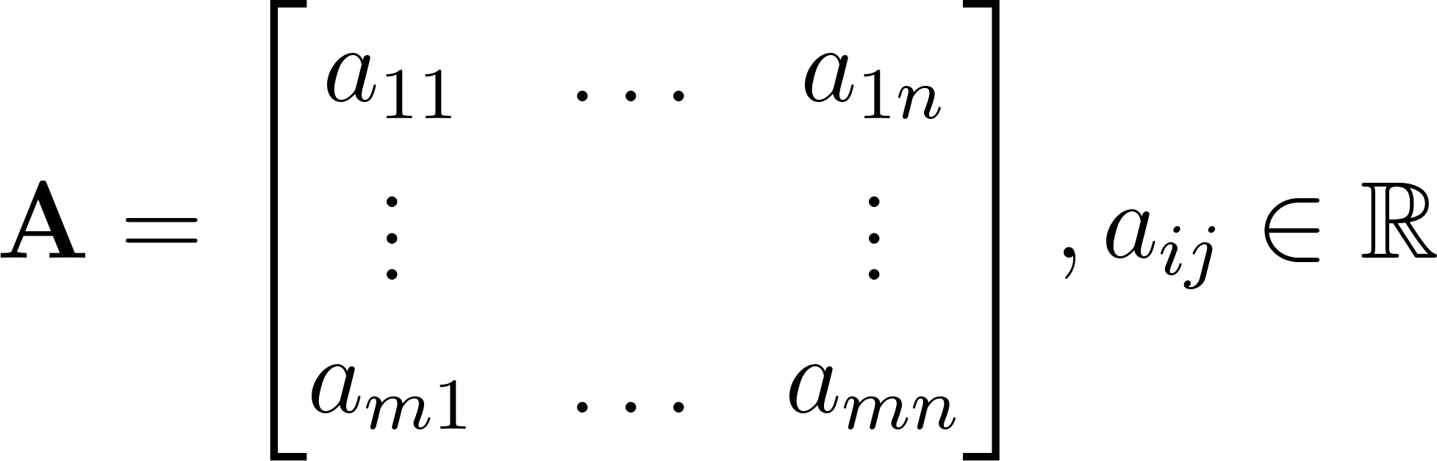
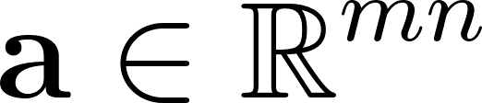

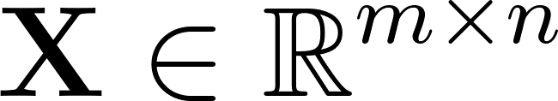
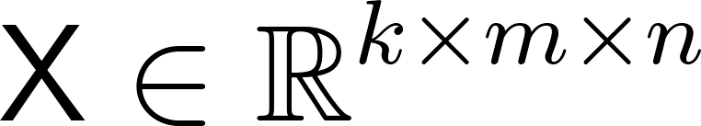

Matrices and Tensors
Matrix, ( rows and columns )
Usually written with (bold upper-case letters).
Can be represented as , by stacking all columns vertically, or concatenating rows horizontally.
Tensor
Stack number of .
The results can be called as 3th-order array, tensor
Can be written with (capital letters with a special font face).

Slide 4
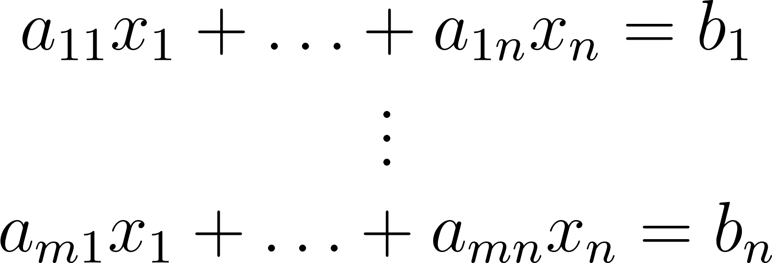
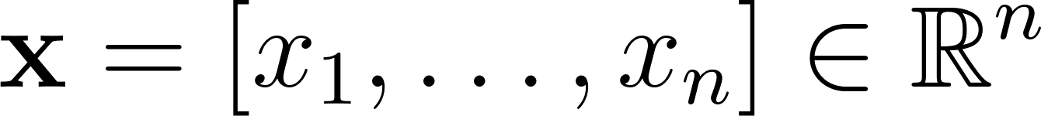
Linear Algebra
Gives us the tools for solving linear equations.
: the unknown variable of this system.
Every that satisfies above equation is a solution of the linear equation system.
There can be one solution, no solution or infinite solutions.

Slide 5
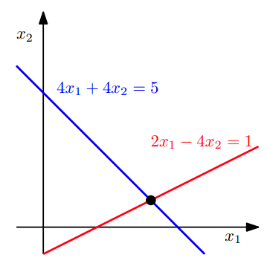

Linear Equation: Example
Each linear equation defines a line on - plane.
A solution set is the intersection of these lines.
Infinite solution : If two equations refers to the same line.
No solution : If two lines are parallel.
When there are three variables,
Each linear equation defines a plane in three-dimensional space.
A solution set is the intersection between planes.
Point
Line
Plane
Empty

Slide 6
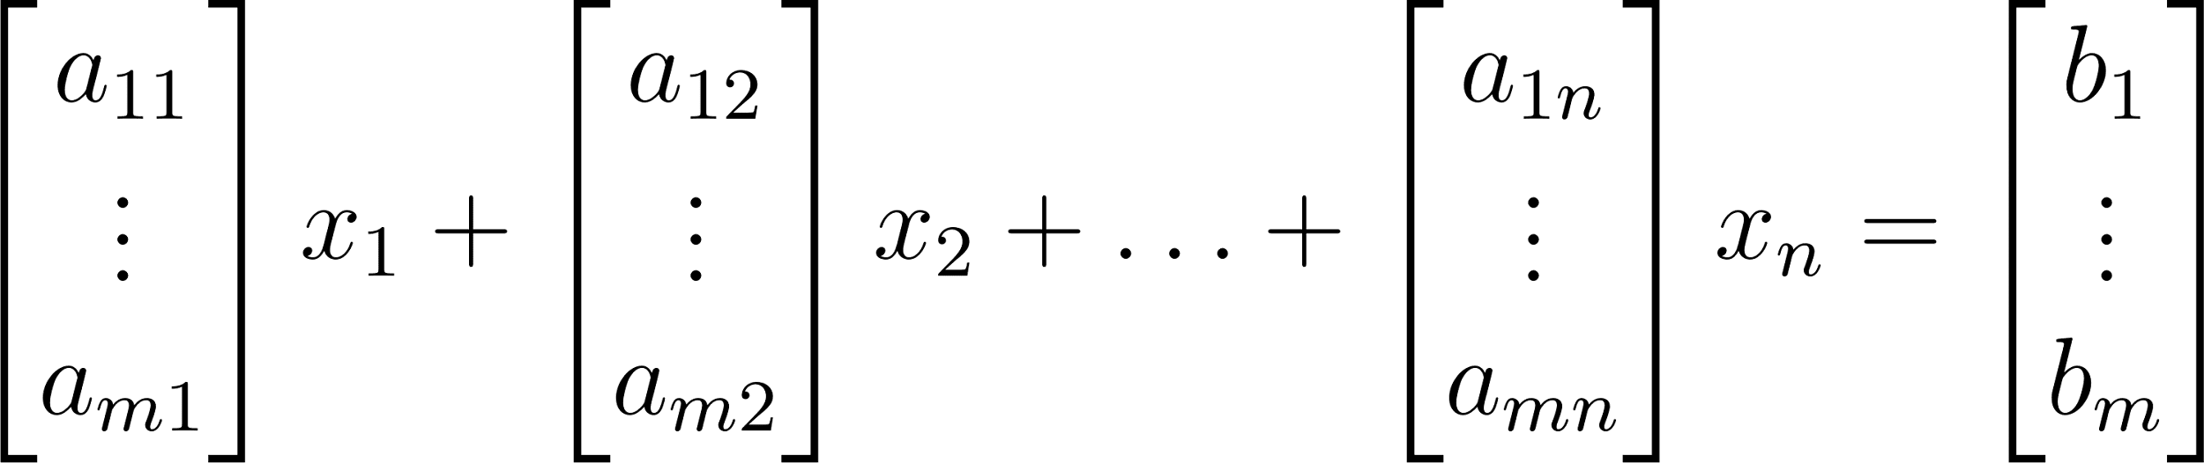
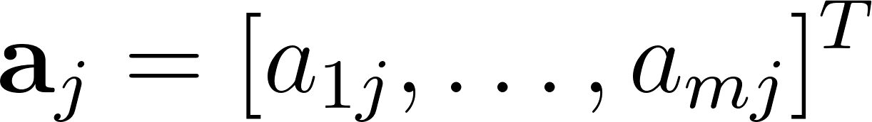
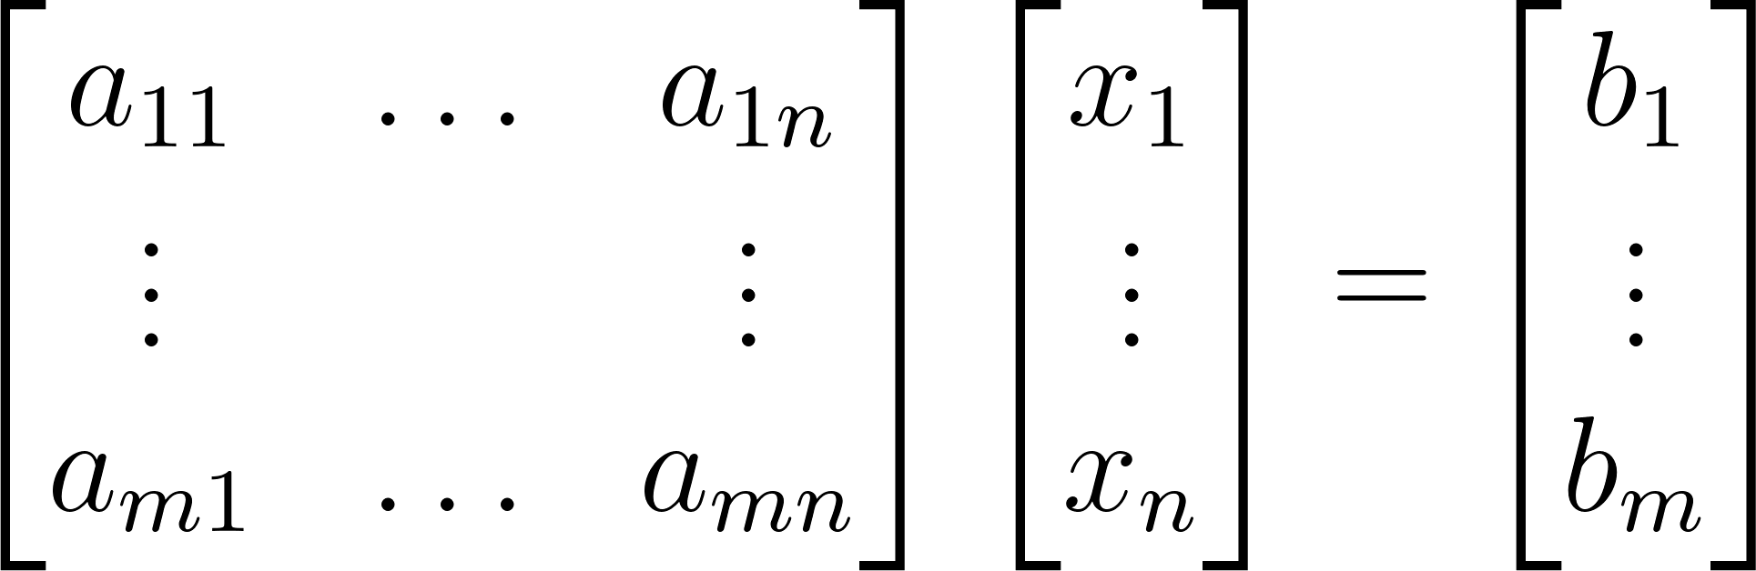

Two ways of representing linear equations
Finding a proper weight vector for this linear combination between column vectors, which are .
: How do we solve this?

Slide 7
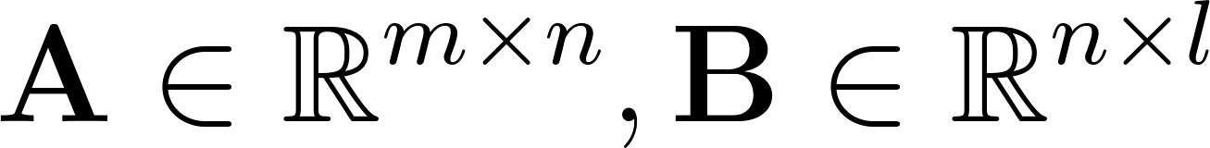

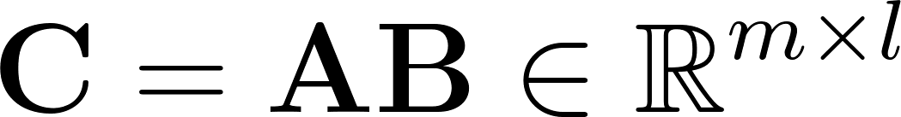


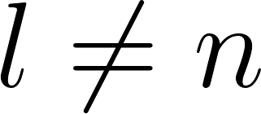

Matrix Addition and Multiplication
Addition : an element-wise sum between two same-sized matrices.
Multiplication
For , the element of the product is :
An inner product between i-th row of with the j-th column of .
# columns of (dim. of row vector) == # rows of (dim. of column vector).
is not defined if .
Element-wise multiplication is called as a Hadamard product.

Slide 8







Associativity and Distributivity of Multiplication
Associativity
For scalar and ,
Distributivity
For scalar and ,

Slide 9
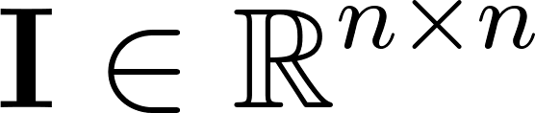
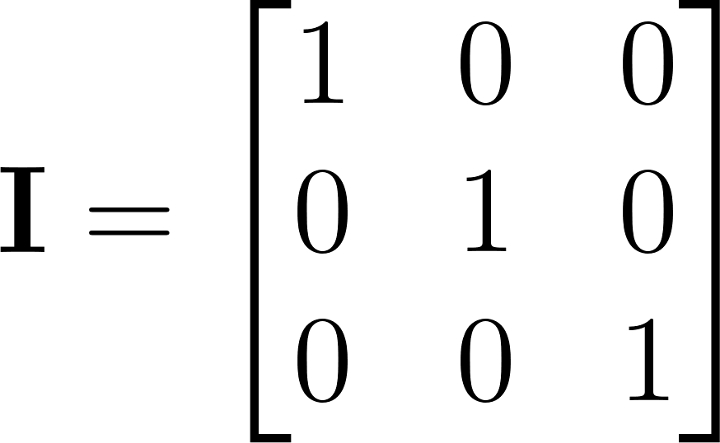

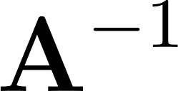
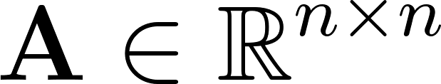
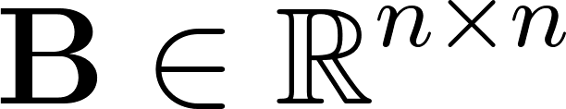

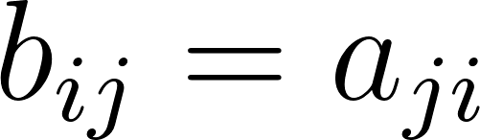


Identity, Inverse and Transpose
Identity Matrix
is an identity matrix if 1 on the diagonal and 0 everywhere else.
ex)
3 x 3 identity matrix
Inverse Matrix
For a square matrix , another square matrix is if .
“Singular, noninvertible” : does not exists.
Transpose: For , with is called the transpose of , written as .
A matrix is symmetric if .

Slide 10


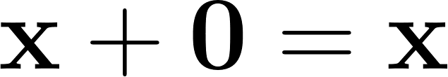

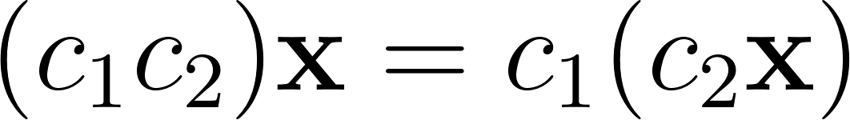
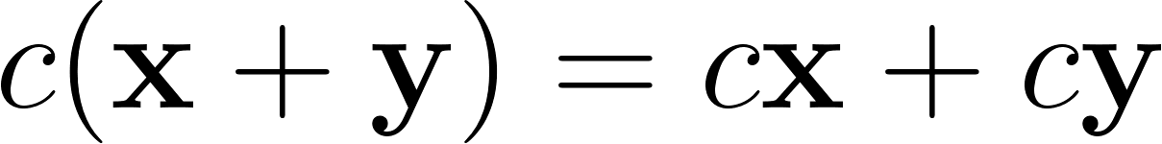
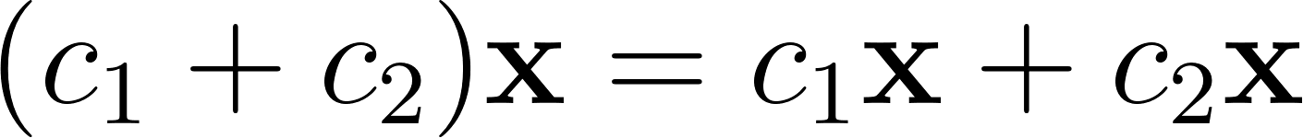
Vector Space
A set of elements (vectors) with rules for “linear combinations”
Addition,
Multiplication by real numbers (scalars).
: a space consists of all column vectors with components.
Addition and Scalar Multiplications are required to satisfy below rules:
There is a unique “zero vector” such that for all .

Slide 11

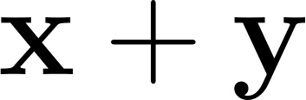


Vector Subspace
A non-empty subset of a vector space:
If and are in the subspace, is in the subspace.
If multiply in the subspace by any scalar , is in the subspace.
Linear combinations stays in the subspace.
“Closed” under addition and scalar multiplication.
A zero vector belongs to every subspace, due to zero scalar.
Example
For a vector space by 3 by 3 matrices,
A set of symmetric matrices. ( ? )
A set of lower triangular matrices is its subspace. ( ? )
A set of matrices with all positive elements. ( ? )

Slide 12





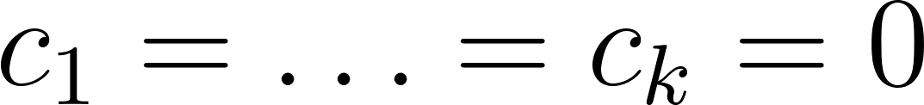

Span, Rank, Linear Independence
Span
If a vector space consists of all linear combinations of , then these vectors span the space.
Every vector in is some combination of the ‘s.
The column space of is “spanned” by its columns.
Rank
The number of genuinely independent rows/columns in the matrix.
When , the matrix has an inverse.
Linear Independence
Vectors are linearly independent,
If only happens when .
If any ‘s are non-zero, the ‘s are linearly dependent
One vector is a linear combination of the others.

Slide 13



Linear Transformations
is a linear transformation if
Consider transformation by matrix : .
If basis : and ,
If we know for each vector in a basis, then we know for each vector in the entire space.
Is composition of two linear transformations is also linear transform?
⇒

Slide 14
Basis for Vector Space
A sequence of vectors having below two properties:
The vectors are linearly independent (not too many vectors).
The vectors span the vector space (not too few vectors).
There is one and only one way to write a vector as a linear combination of basis vectors.
⇒
If columns of a matrix is a basis for , then the matrix must be square and invertible.
⇒
“Dimension” of a vector space is “the number of basis vectors”.

Slide 15
Any Questions?

